Slide 1
Breaking Barriers through Better Communication
Transforming Tech Teams
Presented by Chris Steele

Slide 2
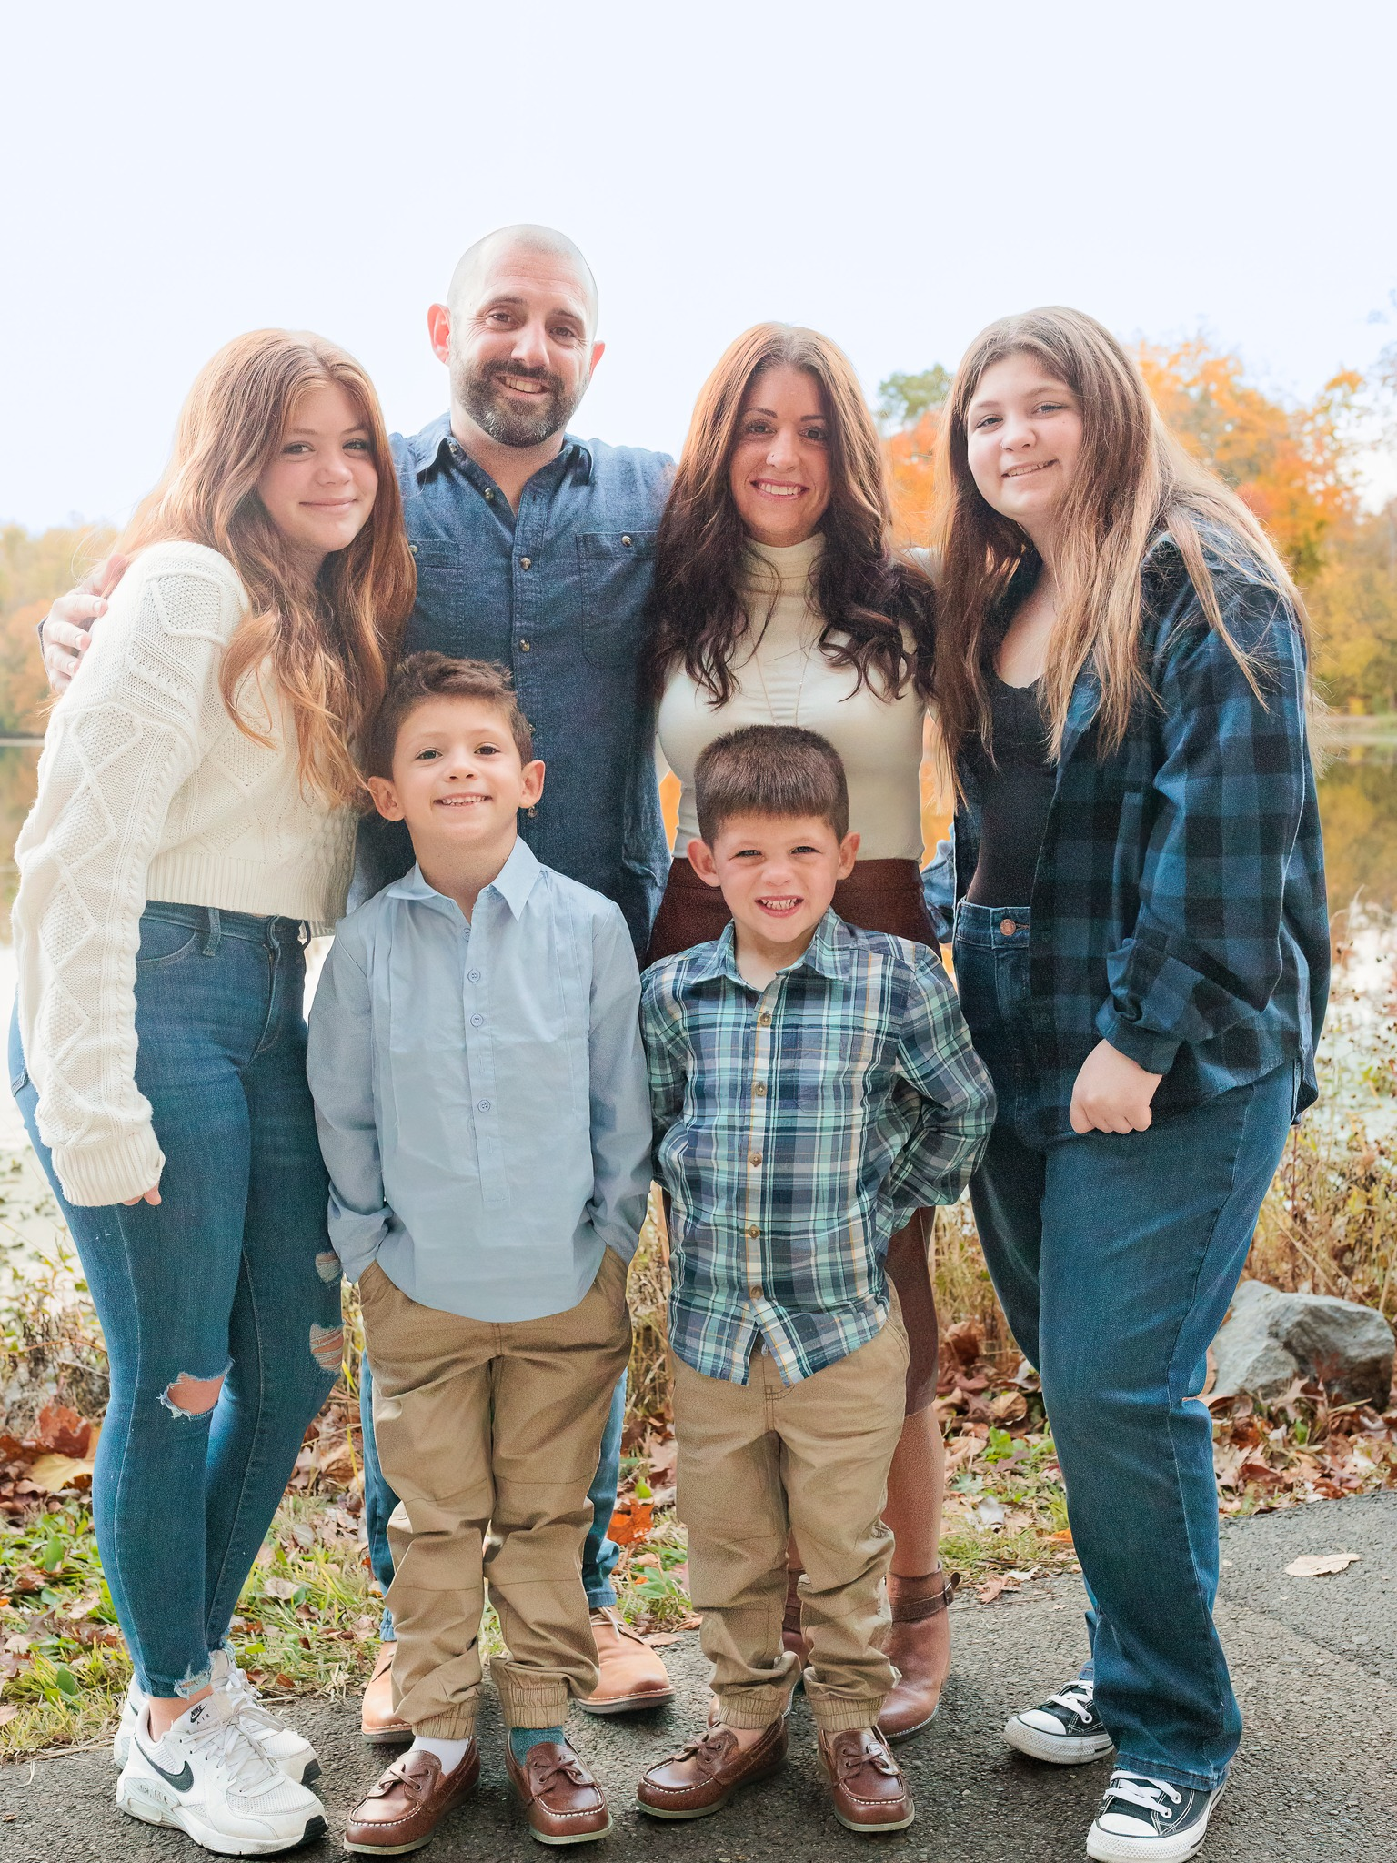
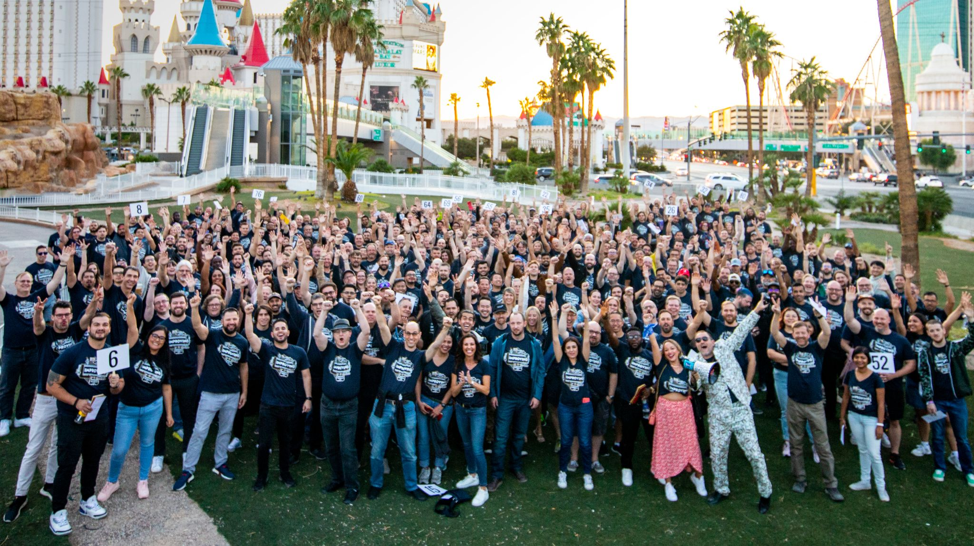
About me
Notes:
Briefly summarize why I want to talk about this
Add two pics – family and work family
Talk about what you don’t see about my background
Most of what we talk about are things I’ve learned along my journey

Slide 3
Today’s focus
What is communication?
Why does communication fail?
How can we do better?

Slide 4
What is communication?
A process by which information is exchanged between individuals through a common system of symbols, signs, or behavior – Merriam-Webster
Notes:
Dig into this with the audience – what’s missing? Is this accurate?

Slide 5
What does this look like in tech teams?
Agile ceremonies
Code reviews
Scoping sessions
1:1’s
And More

Slide 6
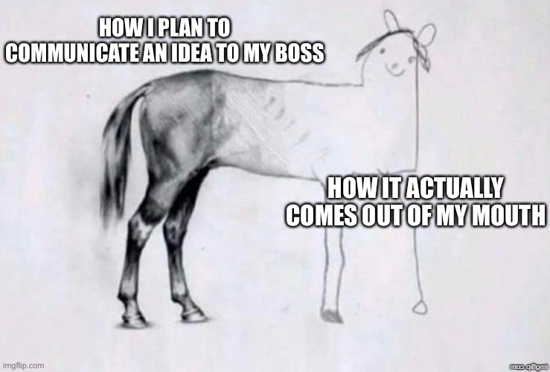
Why does communication fail?
Not listening
Lack of trust
Disagreements
Misunderstanding
Arrogance
Intent not clear
Not a good day
Notes:
Ask the audience

Slide 7
How can we do better?
Become aware
Leverage known strategies
Choose different words/phrases

Slide 8

But wait…
Notes:
Set the stage on the fact that it starts with self

Slide 9
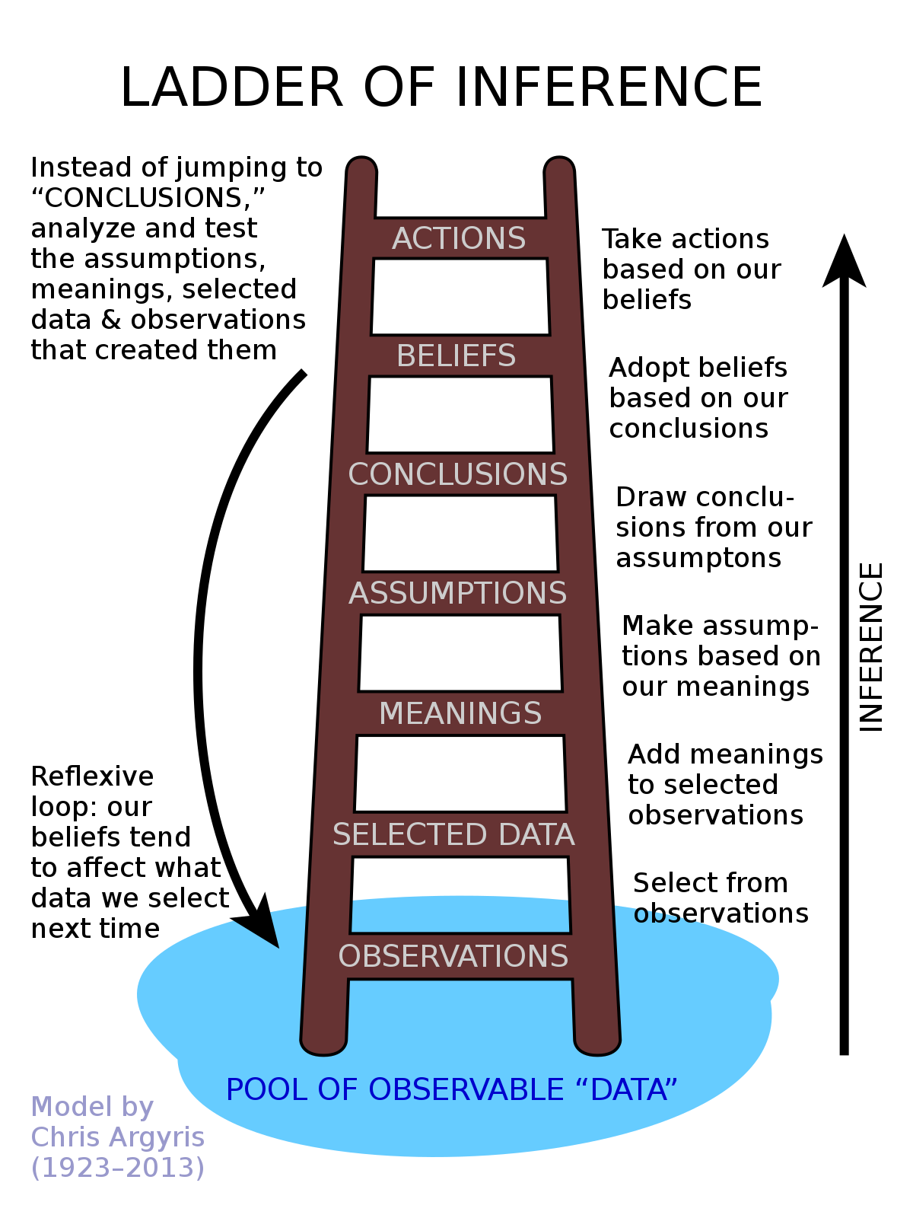
Awareness - Ladder of Inference
Notes:
Talk about an example with driving a car in traffic
Model describing how we make judgements about decisions – cognitive biases – 2 + 2 = 5
Identify where you are, analyze your thoughts (what and why)
Work backwards from where you found yourself and then forwards
Mention ”the story that I’m telling myself”

Slide 10

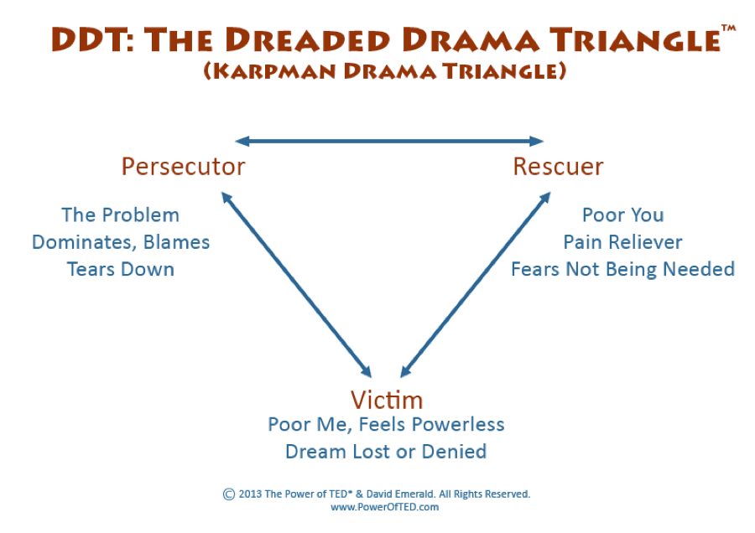
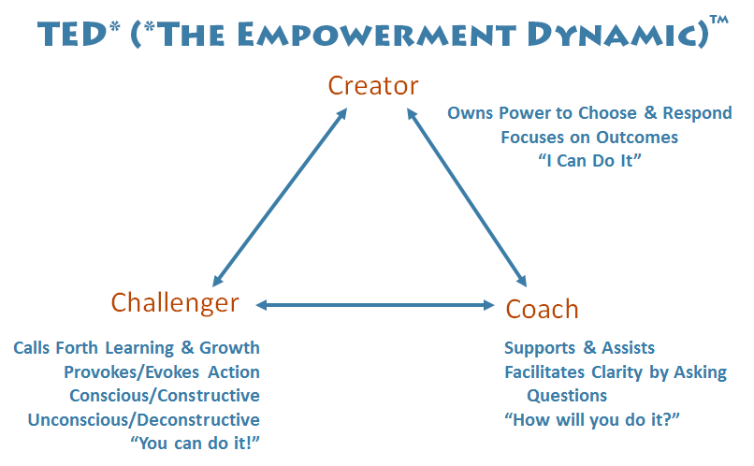
Awareness – Power of TED

Slide 11
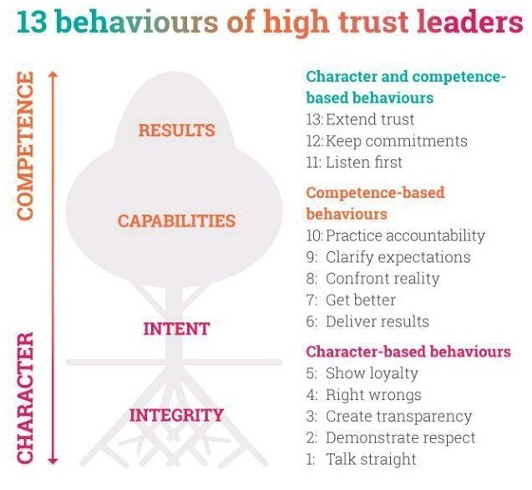

Strategies – Speed of Trust

Slide 12
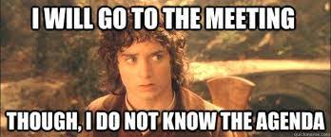
Strategies – When in Meetings
Have an agenda or meeting strategy
Choose the right people
Leaders talk last
Use "yes and" approach
End with recap, commitments, accountability, and timelines
Notes:
Mention “Death by Meetings” by Patrick Lencioni - Daily Check-in, weekly tactical, monthly strategy, quarterly off-site review
Ask the audience

Slide 13
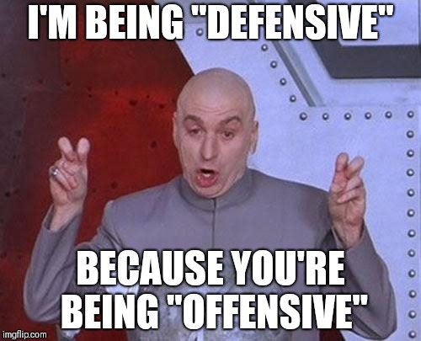
Strategies – Preventing Defensiveness
LISTEN
PAUSE
Agree with the person
Acknowledge their feelings
Tell them what you’ve learned/heard
Tell them how helpful it was
What else?
Notes:
Active listening – Seek first to understand
Ask the audience

Slide 14
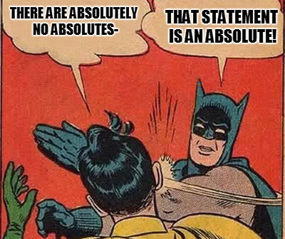
Word Choice – Remove Absolutes
Always / Never
Everyone / No One
Anything / Everything
What else?
Notes:
Personal pet peeve

Slide 15
Word Choice - Phrases
Why… => Can you help me understand
I’m too busy => I have not made time for it
Would you be opposed to…
You should… => Have you considered
But... => I love you and I do not like...

Slide 16
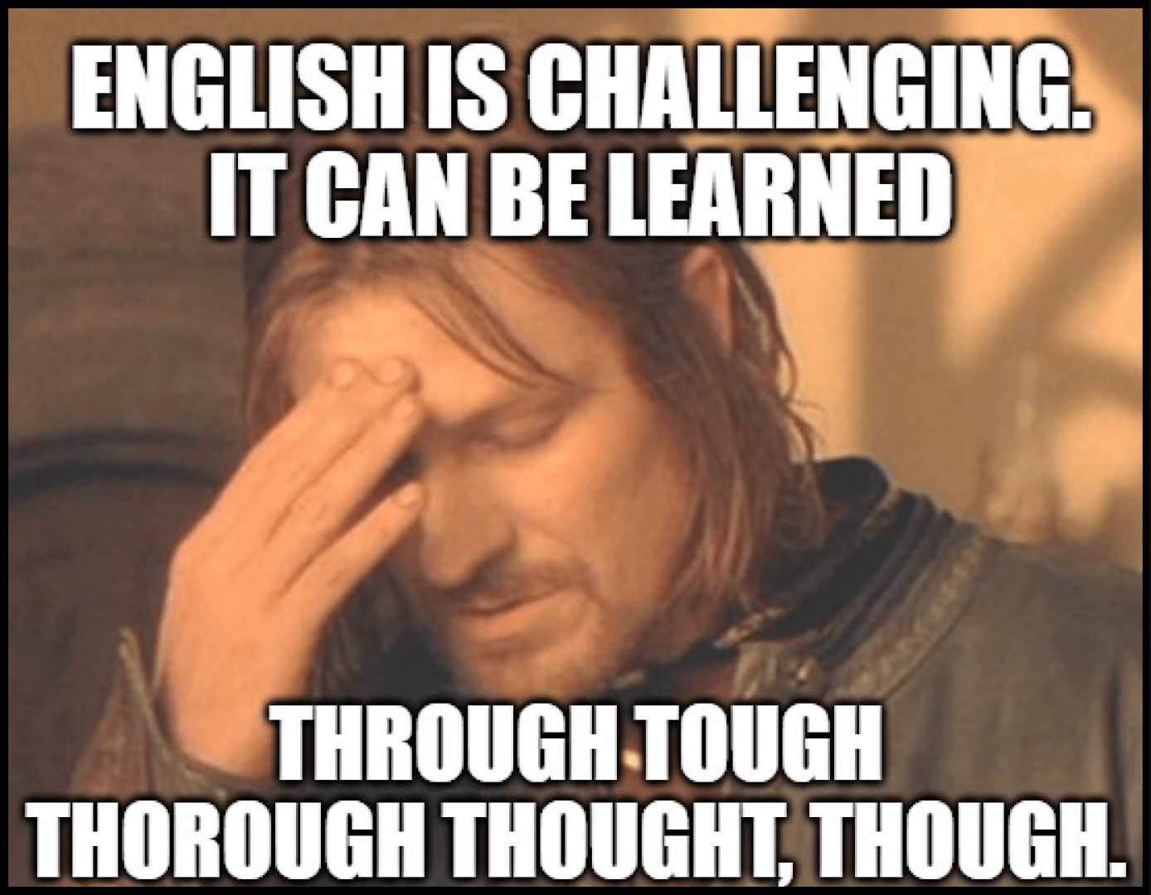
Word Choice – Words are hard!
Just
Kind of
Trust/believe me
No offense
What else?

Slide 17
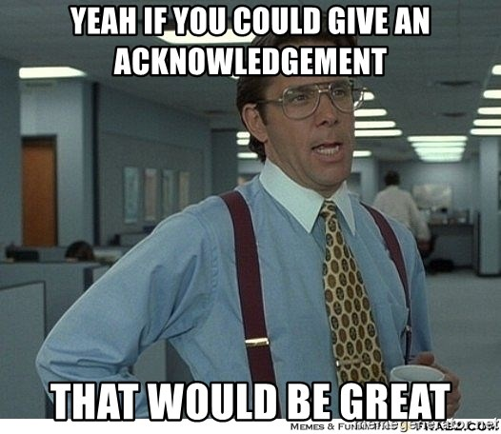
Special Mention - Acknowledgment
Notes:
This is what really inspired the talk

Slide 18
What are some of your techniques?

Slide 19
What did we learn?
Ladder of inference
Power of TED
Self
Awareness
Strategies
Word choices
<insert yours>
Speed of Trust
Effective meetings
Preventing defensiveness
Remove absolutes
Change phrases
Avoid certain words
Notes:
Don’t forget to mention self!

Slide 20

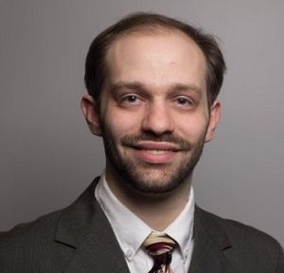
Shout-out
Talks to see tomorrow – 5/25!
9:00 am – Amanda Lange
The Power of Listening: Improving Communication in the Tech Industry
10:30 am – Kyle Jenkins
From Blind Trust to Real Trust: Practical Steps for IT Teams

Slide 21
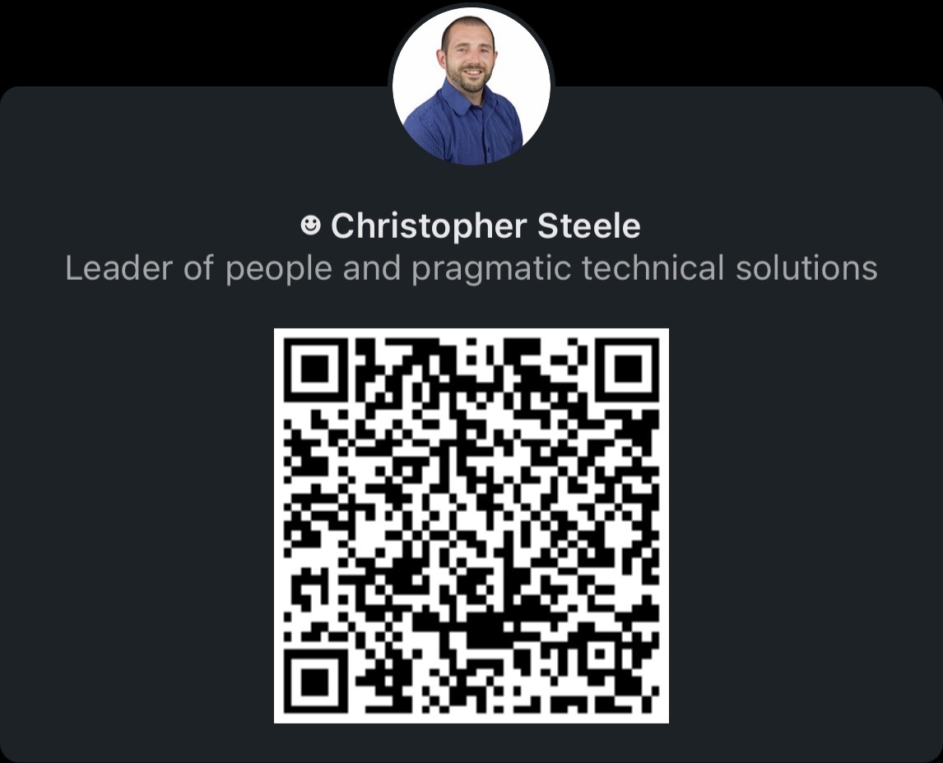
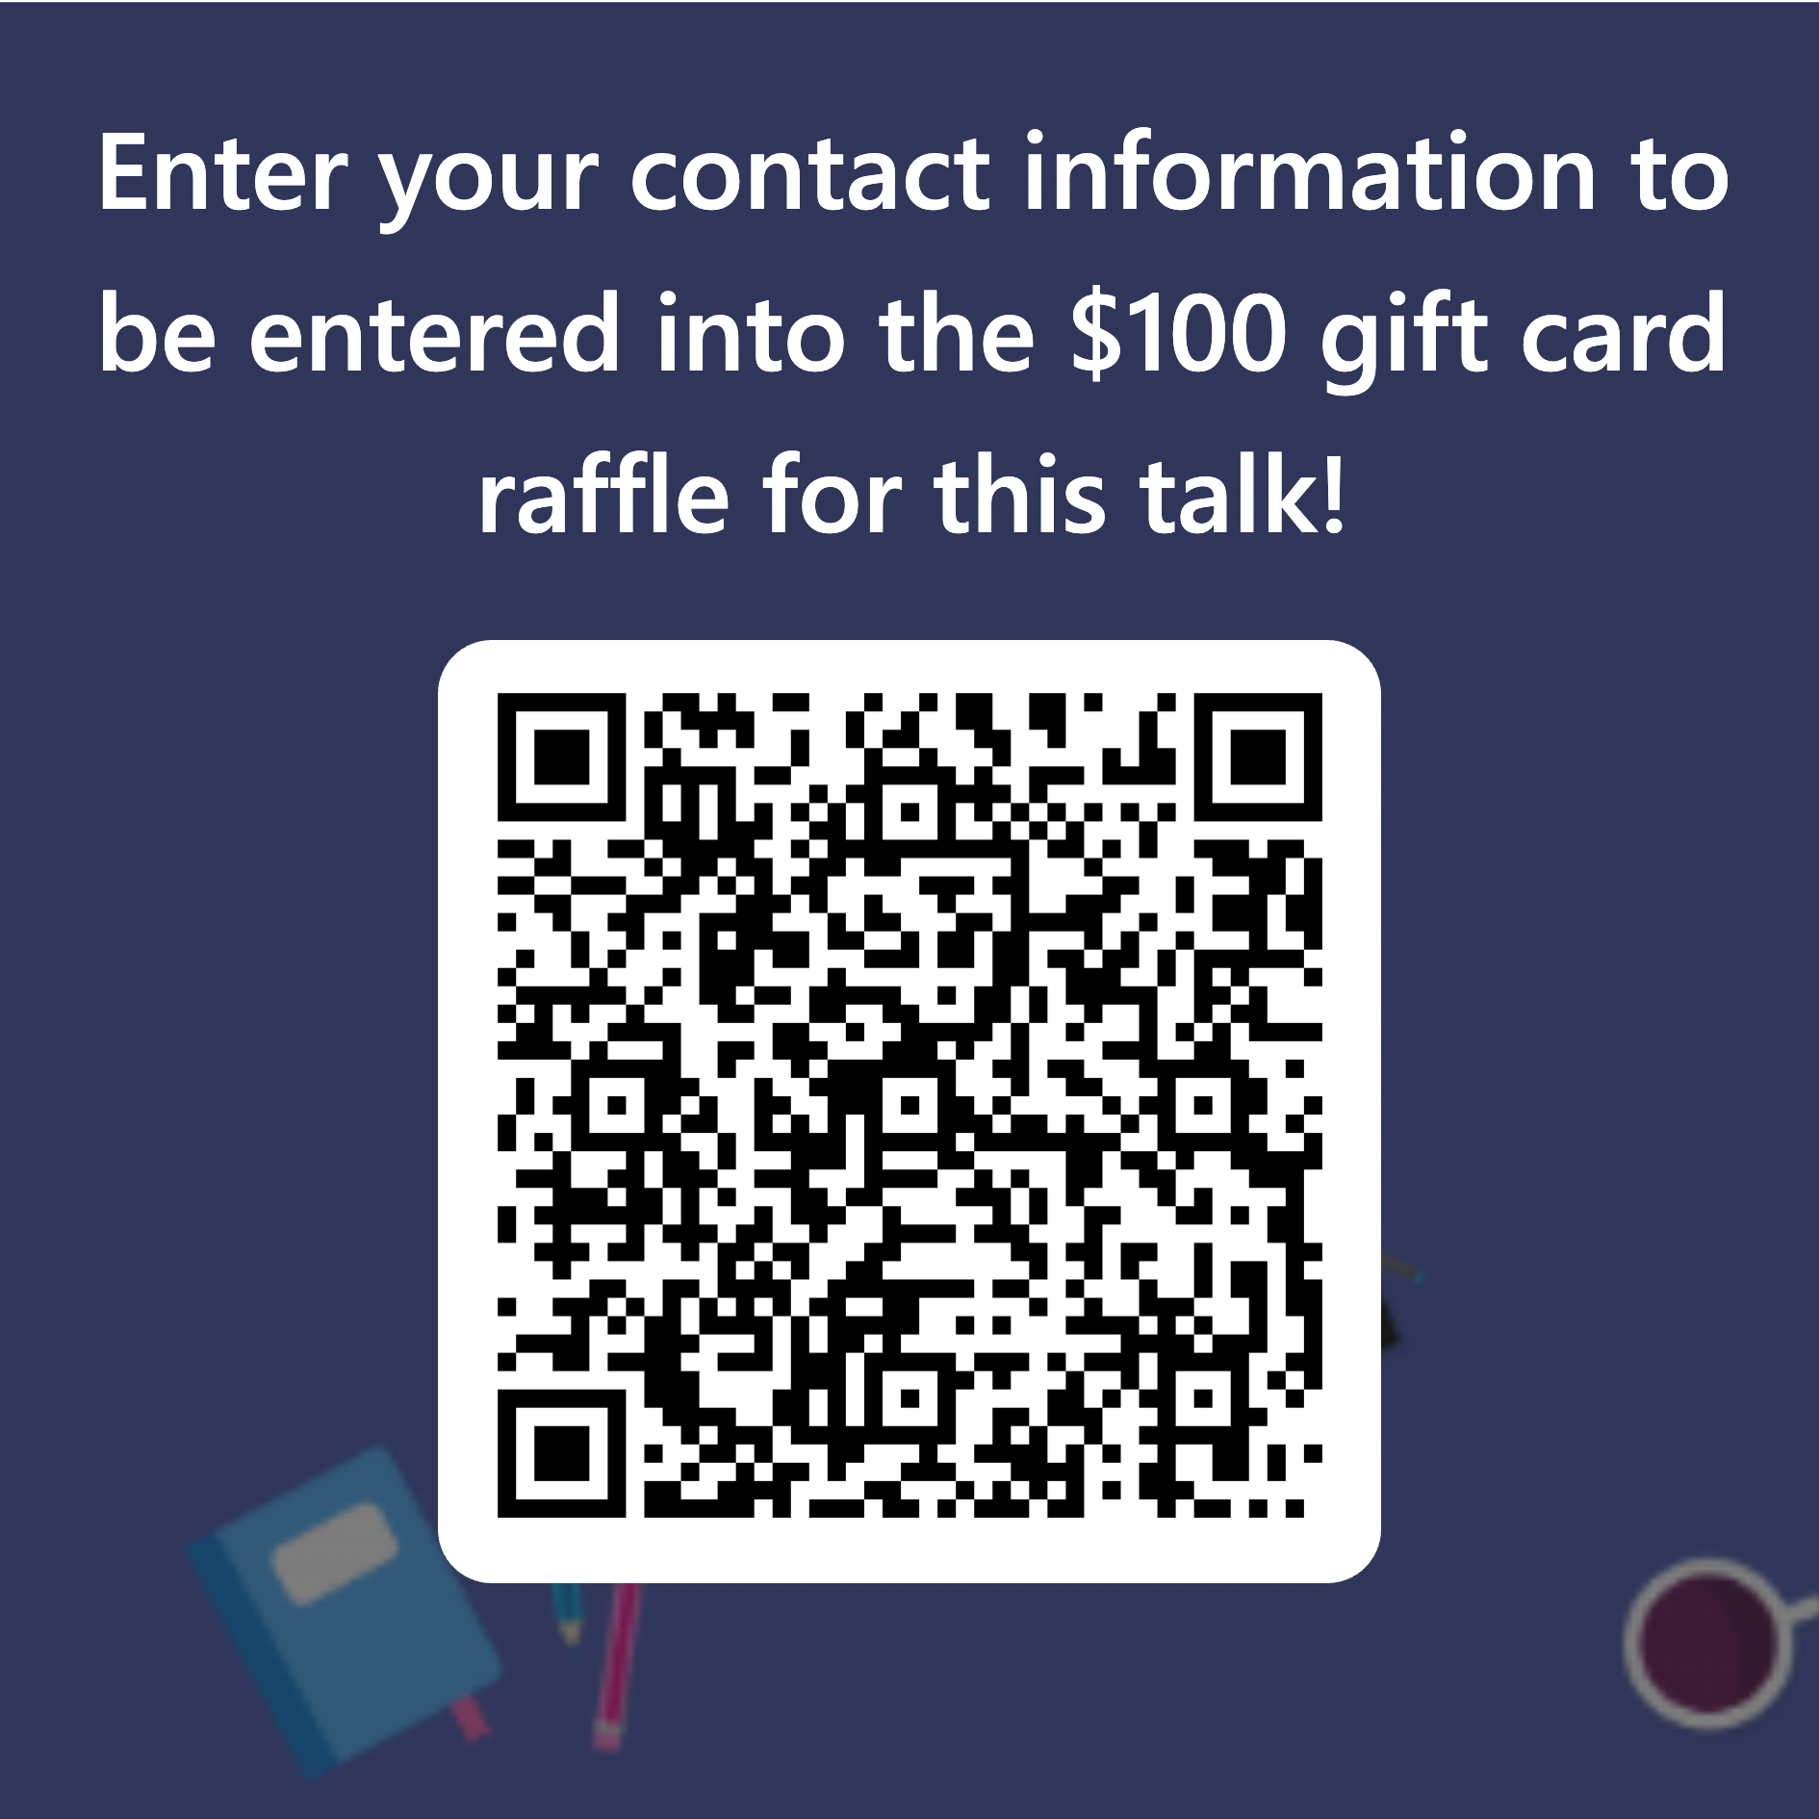
Thank you!
Notes:
Changes for future talks:
Add a crucial conversation slide
Add a non-verbal slide
Add “open ended questions” in meetings

